Slide 1
FYP5: Object Detection, Tracking and Suspicious Activity Recognition for Maritime Surveillance using Thermal Vision

Slide 2
Action Detection - ROAD
Successfully trained VGG16 from scratch on UCF24
Integrated CornerNet-Lite Squeeze and began training on UCF24
Loss decreases but accuracy (mAP score) is 0.
Searching for bugs in the integration code
Considering trying another model (CenterNet)

Slide 3
Action Detection - ROAD
Conversion of MatLab files to Python for temporal evaluation of the Action Tubes generated – Using 300 videos out of 910 test videos of UCF24
IoU_th | tmIoU | tmAP (%) | tacc (%)
0.2 | 0.067 | 26.63 | 92.33
0.5 | 0.067 | 12.54 | 92.33
IoU_th – IoU threshold used
tmIoU – mean IoU value returned considering the temporal IoUs returned for each video
tmAP – temporal mean AP
tacc – accuracy in predicting correct class of action (frame-wise)

Slide 4
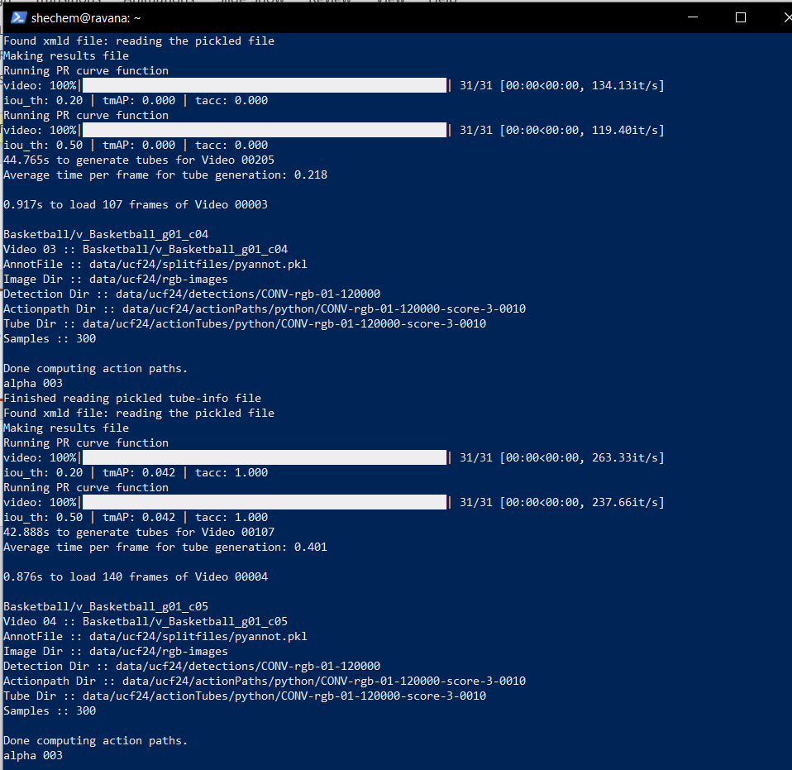
Action Detection - ROAD
Linking frame-wise detection script and Online-Tube generation scripts to run together video-wise
Avg. time to load a frame | 7ms
Total Avg. time to generate tubes per video* | 44.1s
Avg. time to incrementally link a tube to next frame | 0.29s
*may increase slightly when multiple tubes are to be linked for proceeding frame detections

Slide 5
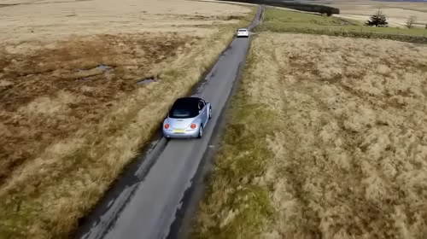
Object Tracking
KCF Tracker
Median Flow Tracker
CSRT Tracker
MOSSE Tracker

Slide 6
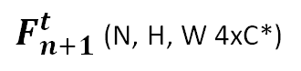
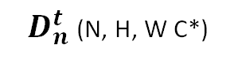
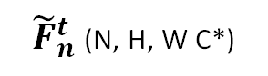
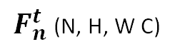
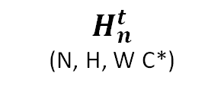
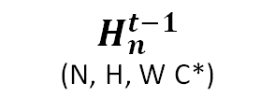
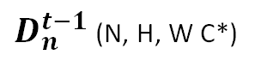
$F_{n}^{t}$ (N, H, W C)
1x1 2D Conv
1x1 2D Conv
1x1 2D Conv
$D_{n}^{t−1}$ (N, H, W C*)
$D_{n}^{t}$ (N, H, W C*)
3x3 2D Conv
3x3 ConvLSTM
3x3 2D Conv
-
$H_{n}^{t−1}$
(N, H, W C*)
$H_{n}^{t}$
(N, H, W C*)
Spatio-Temporal Block Design
${\tilde{F}}_{n}^{t}$ (N, H, W C*)
1x1 2D Conv
1x1 2D Conv
1x1 2D Conv
+
$F_{n+1}^{t}$ (N, H, W 4xC*)

Slide 7

Tasks for next week
Work on the integration of CenterNet with ROAD
Conversion of MATLAB scripts to Python to load frame-by-frame and generate action tubes
Creating the pipeline for ROAD

